Slide 1
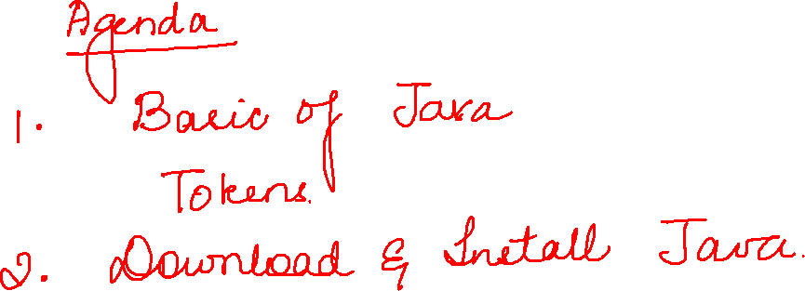

Slide 2
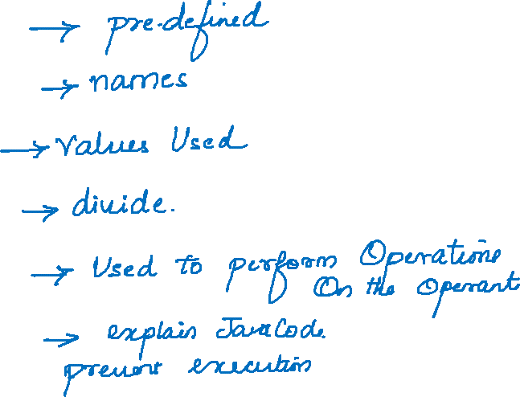

Slide 3
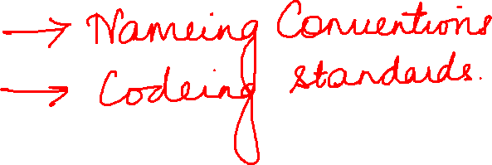

Slide 4
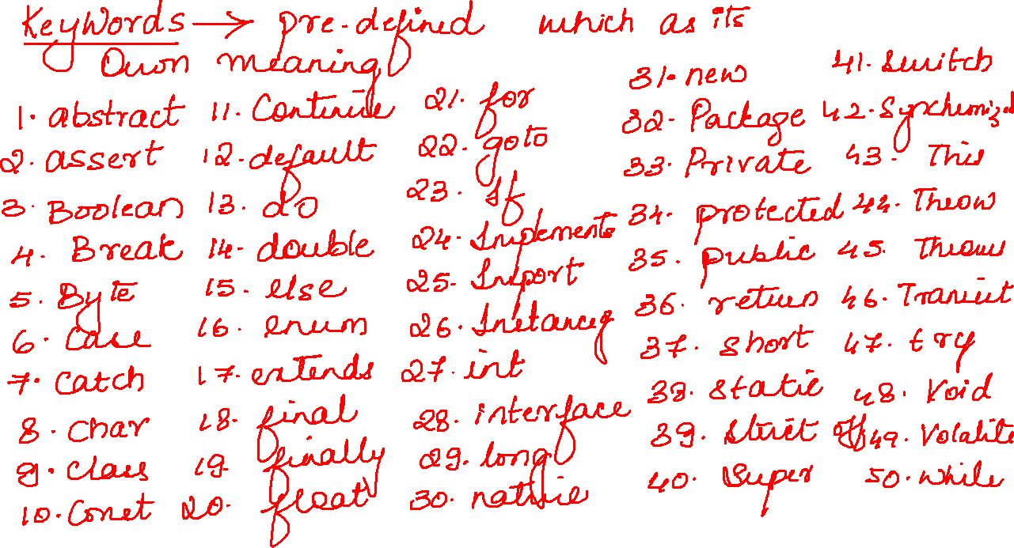

Slide 5
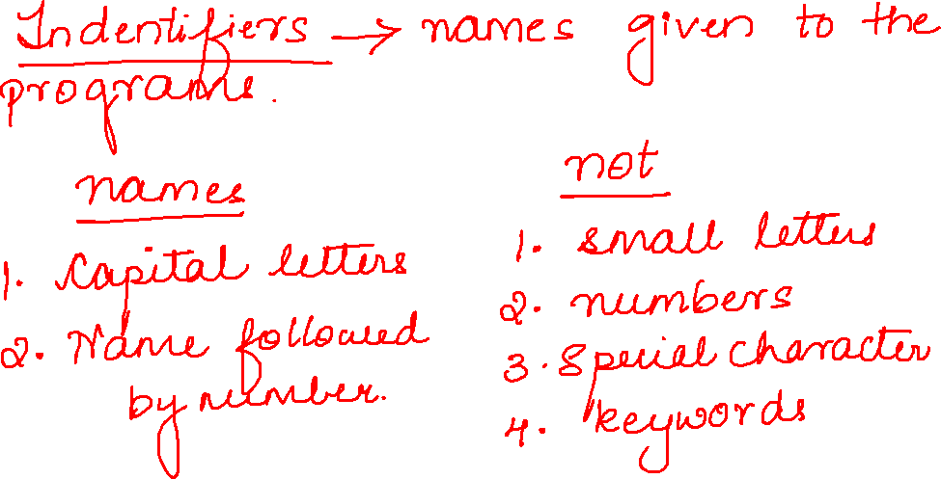

Slide 6
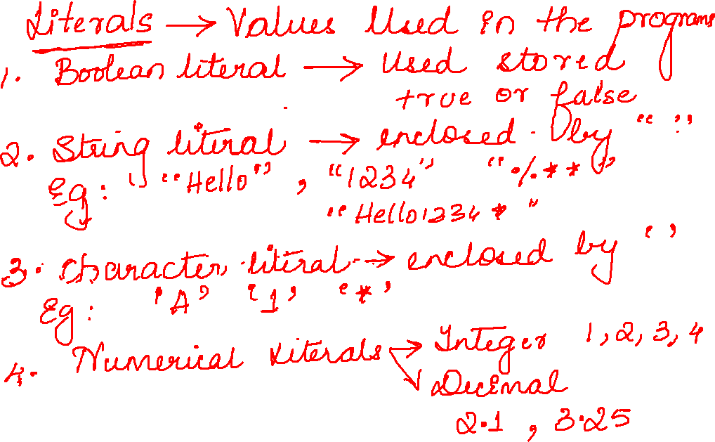

Slide 7
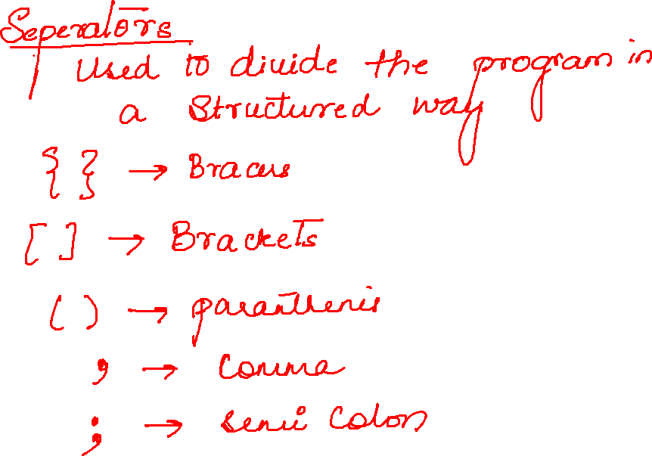

Slide 8
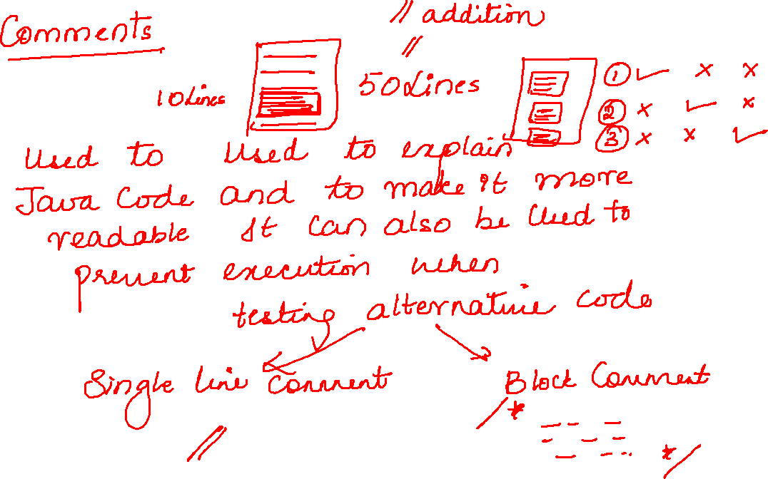

Slide 9
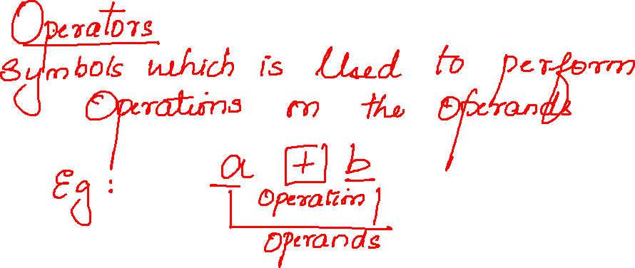

Slide 10
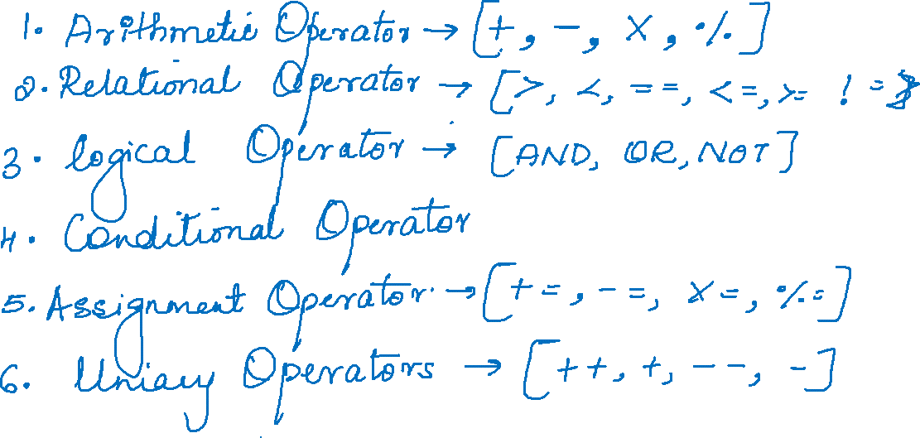

Slide 11
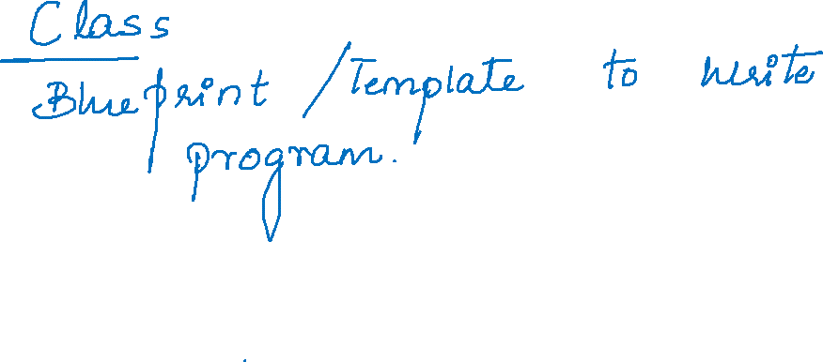

Slide 12
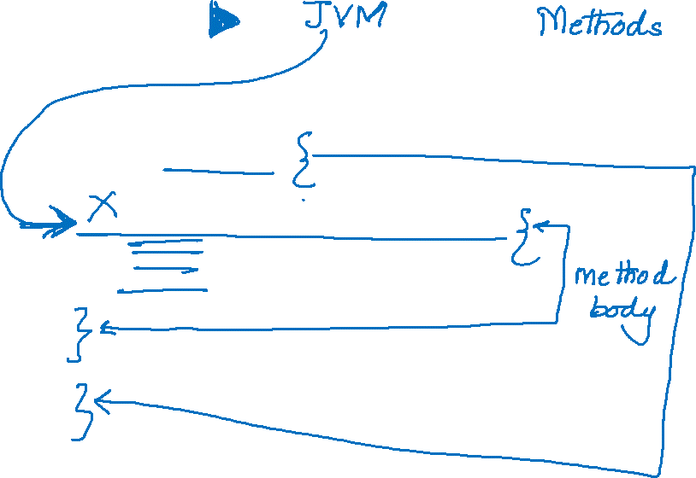
public class Test1 {
public static void main(String[] args) {
}
}

Slide 13
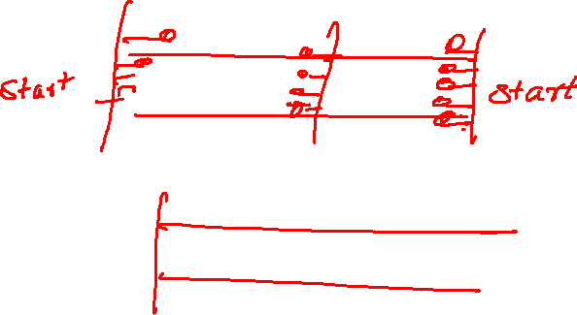

Slide 14
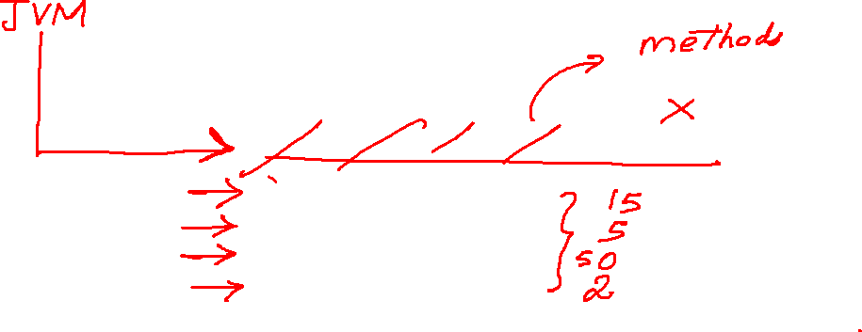
public class Test1 {
public static void main(String[] args) {
System.out.println(10+5);
System.out.println(10-5);
System.out.println(10*5);
System.out.println(10/5);
}
}

Slide 15
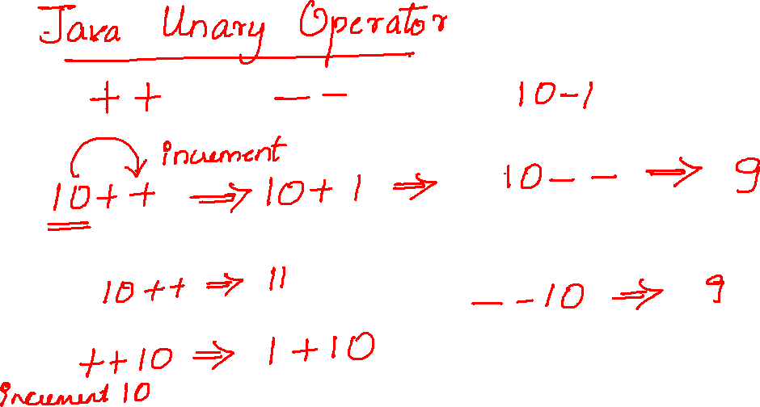

Slide 16
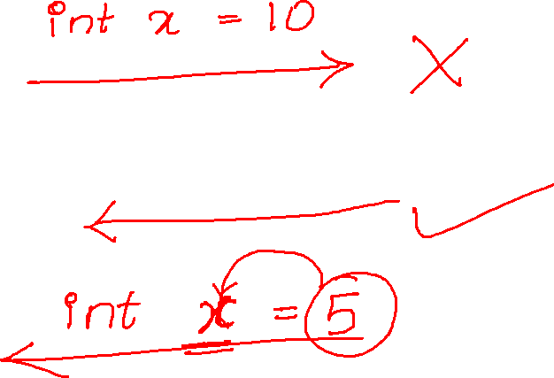

Slide 17
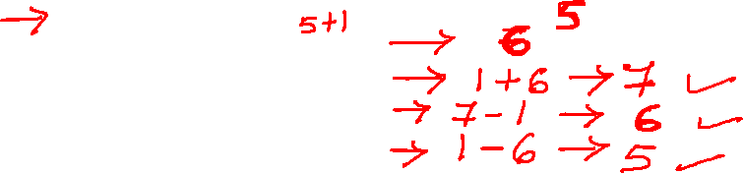
int x=5;
System.out.println(x++);
System.out.println(++x);
System.out.println(x--);
System.out.println(--x);

Slide 18
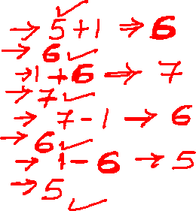
int x=5;
System.out.println(x++);
System.out.println(x);
System.out.println(++x);
System.out.println(x);
System.out.println(x--);
System.out.println(x);
System.out.println(--x);
System.out.println(x);

Slide 19
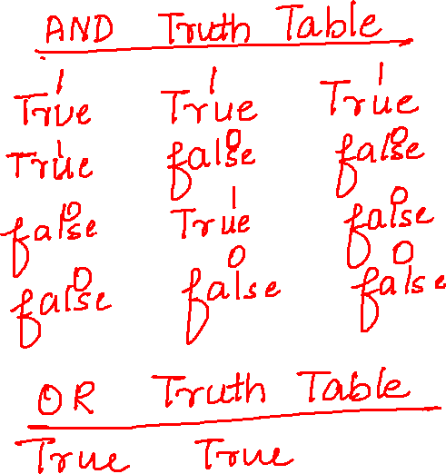
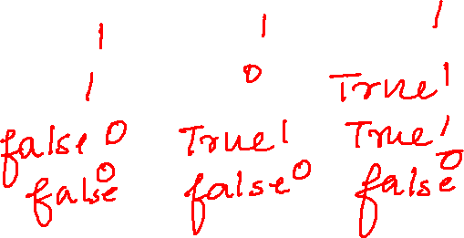

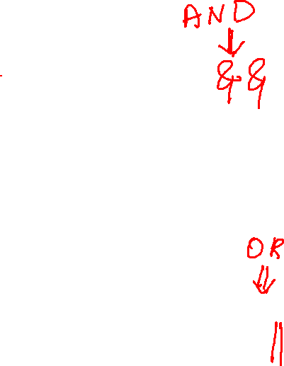

Slide 20

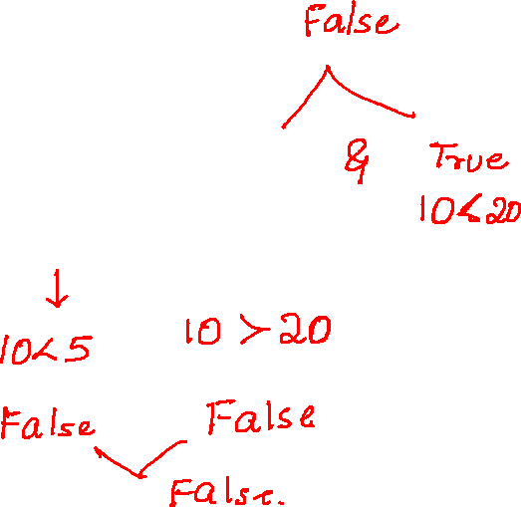
int a=10;
int b=5;
int c=20;
System.out.println(a<b&&a<c);
System.out.println(a<b&&a>b);

Slide 21
